Slide 1

Diagnostic Analysis for Super Store
By
Harini K
36822006
MCA

Slide 2

Team members
Harini K – Diagnostic Analysis.
Ananya Manoj – Descriptive Analysis.
Maghalakshmi R – Prescriptive Analysis.
Nandhini Devi M – Location Analysis.
Nithiyasri S – Cost Analysis.
Praveen R – Predictive Analysis.

Slide 3
Introduction
Super Store is a small retail business located in the United States. They sell Furniture, Office Supplies and Technology products and their customers are the mass Consumer, Corporate and Home Offices.
The data set contains sales, profit and geographical information of Super Store.
Our task is to analyse the sales data and identify weak areas and opportunities for Super Store to boost business growth.

Slide 4

Diagnostic Analysis
Objective: To Conduct correlation analysis to understand relationships between sales, profit, and discount. Identify and rank top-performing products by sales. Perform time series analysis to uncover trends. Examine the distribution of products across categories and sub-categories to inform marketing and expansion strategies.

Slide 5
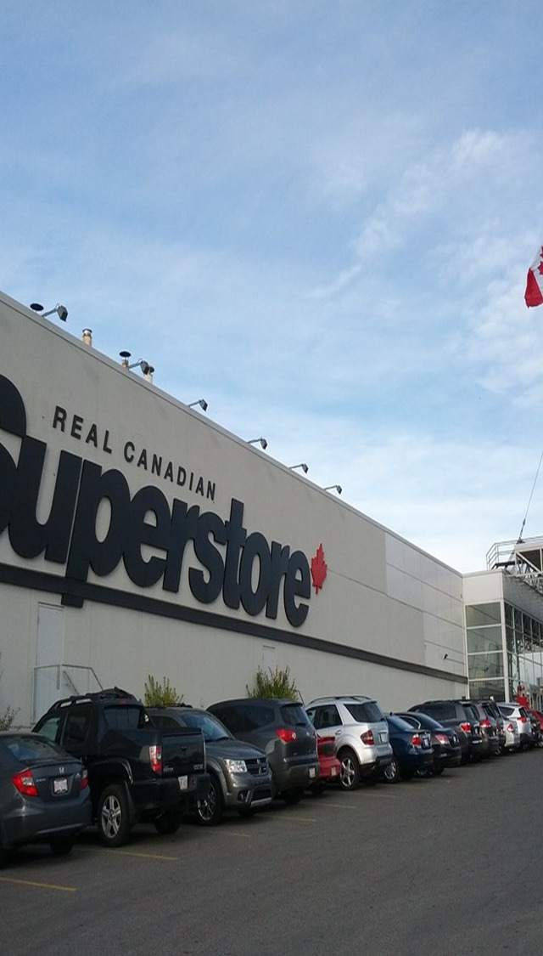
Dataset
Sample - Superstore.csv , downloaded from tableau – salesforce.
Dataset contains: Row ID ,Order ID ,Order Date, Ship Date ,Ship Mode ,Customer ID, Customer Name, Segment Country, City, State, Postal Code ,Region, Product ID, Category, Sub-Category, Product Name, Sales, Quantity ,Discount, Profit, Latitude, Longitude.

Slide 6
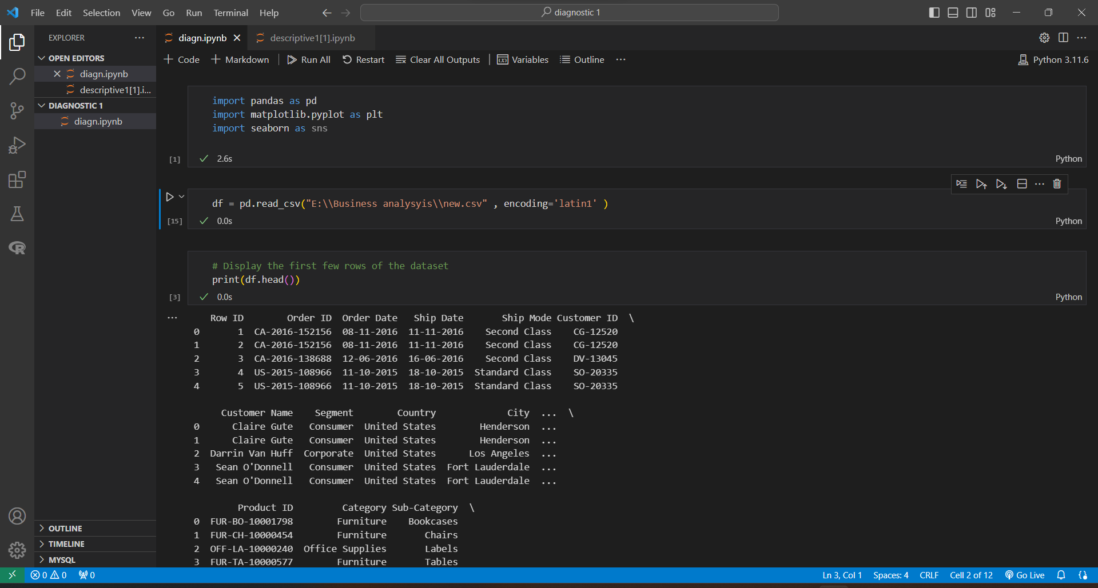
Implementation
Importing necessary libraries and dataset

Slide 7
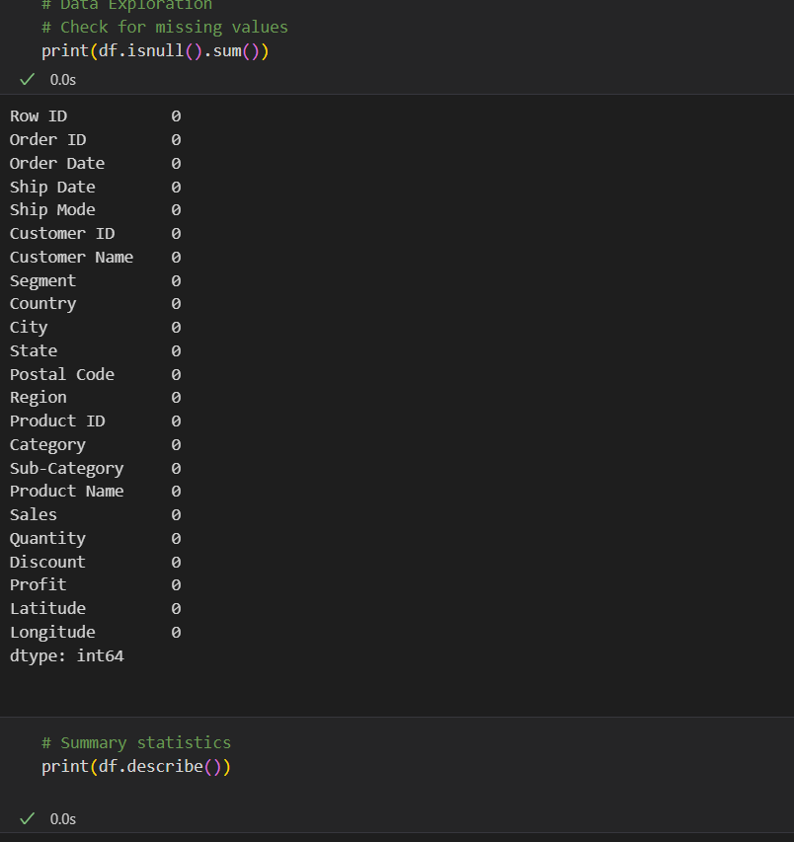
Implementation
Data Exploration

Slide 8
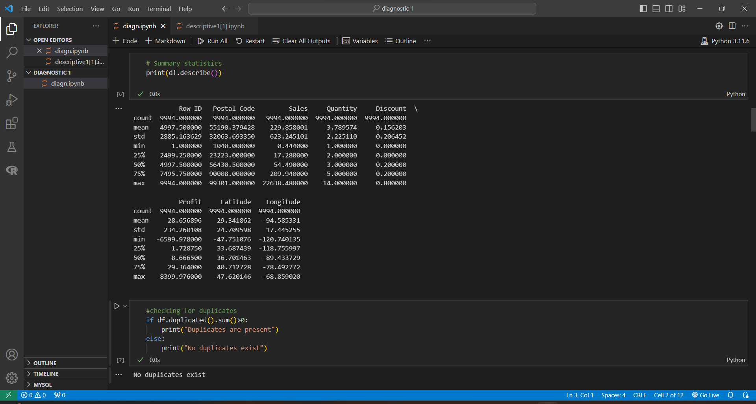
Implementation
Checking for duplicates

Slide 9
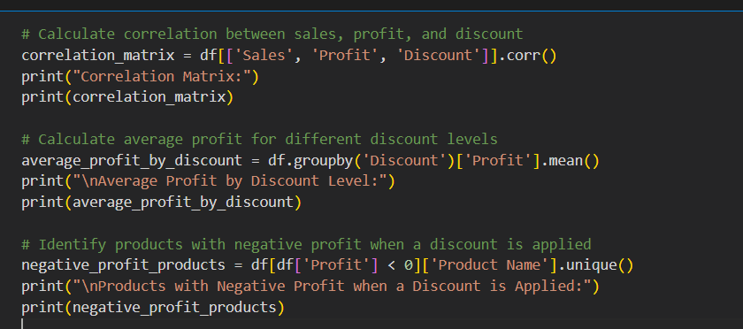
Calculating correlation between sales, profit, and discount

Slide 10
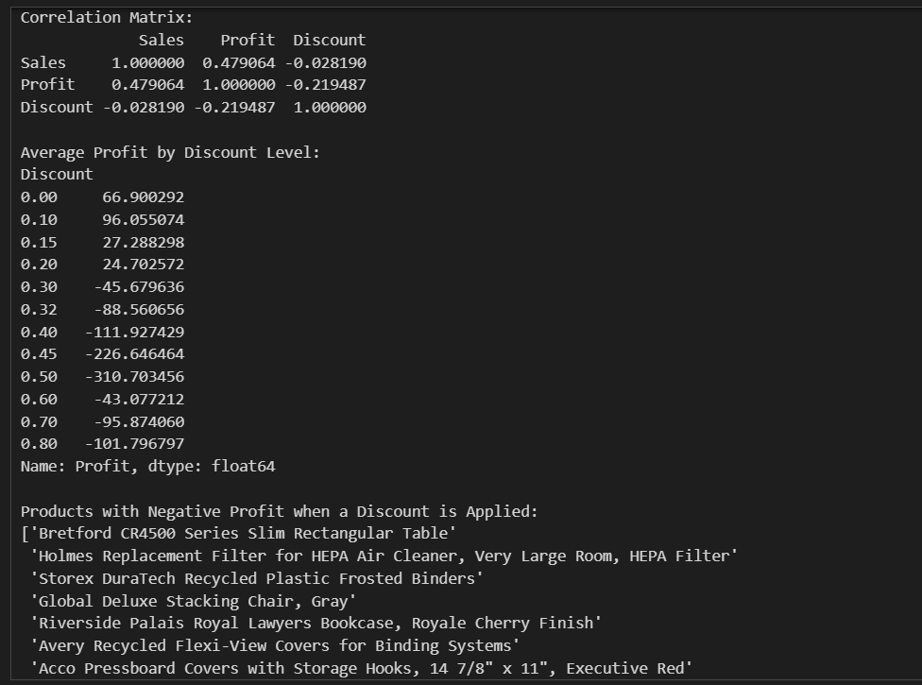
Output

Slide 11
INFERENCE: Negative profit on products with discounts. Correlation between sales, profit, and discount. Avg. profit decreases with higher discounts. INTERPRETATION: The correlation matrix provides insights into the relationships between sales, profit, and discounts. It seems that offering higher discounts is associated with lower profits. The average profit analysis by discount level confirms that higher discounts generally lead to lower average profits. The list of products with negative profit when a discount is applied can be used for further analysis and decision-making. It might be necessary to revisit the pricing strategy for these products or explore ways to reduce costs.
“
”

Slide 12
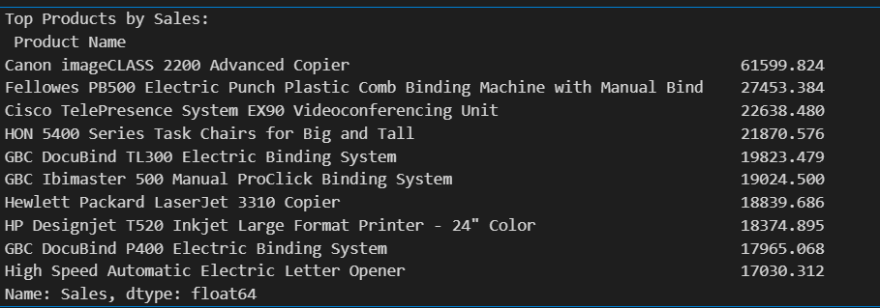
Top products by sales
top_products = df.groupby('Product Name')['Sales'].sum().nlargest(10)
print("Top Products by Sales:\n", top_products)

Slide 13
INFERENCE: The sales data reveals that certain products significantly outperform others. The Canon imageCLASS 2200 Advanced Copier has the highest sales at $61,599.82, indicating its popularity and demand. Other products in the list also contribute substantially to overall sales. INTERPRETATION: The top-selling products, such as advanced copiers and binding machines, suggest a high market demand for office equipment and productivity tools. Businesses may prioritize these items for efficient operations and document management. The popularity of specific products can guide inventory and marketing strategies.
“
”

Slide 14
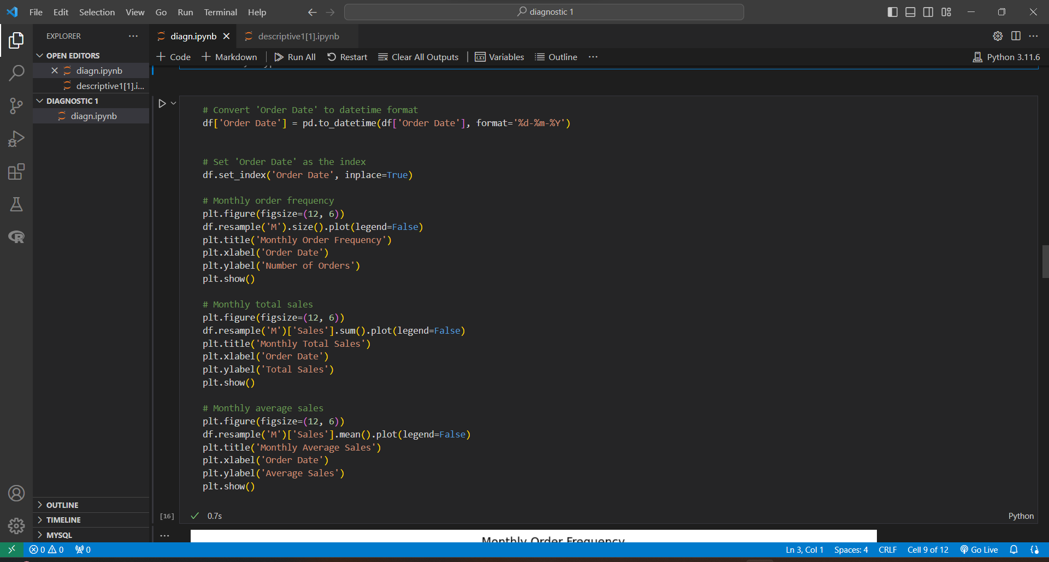
Time Series Analysis

Slide 15
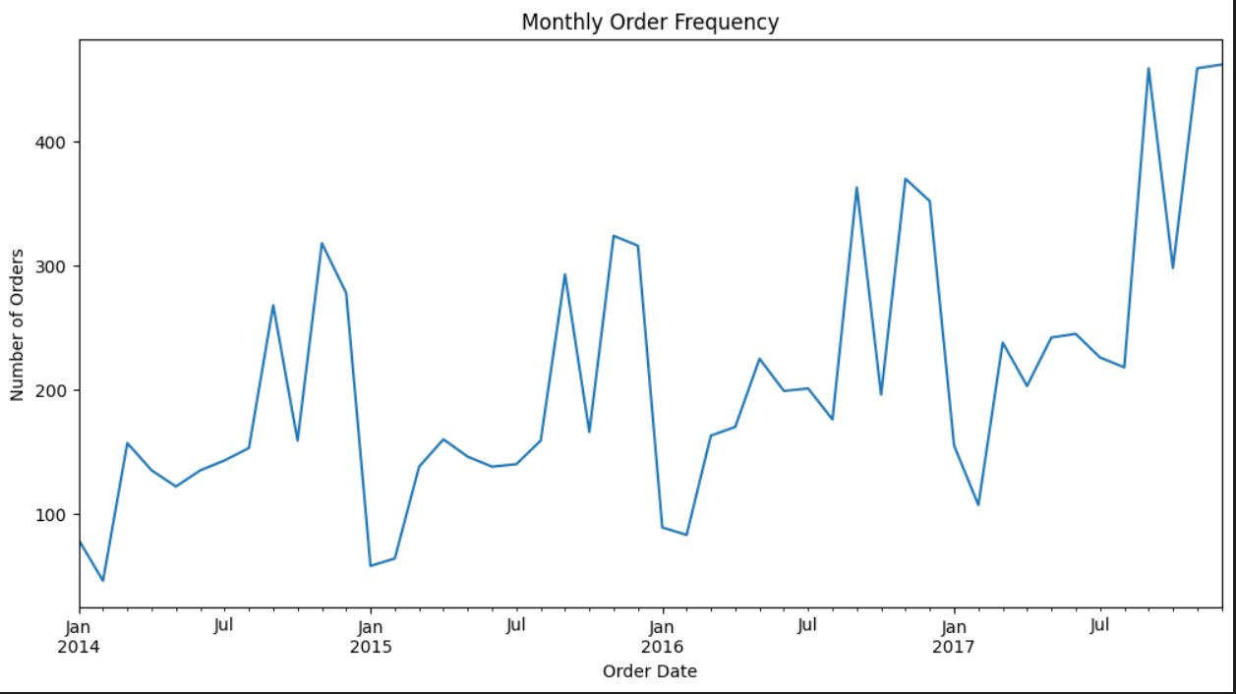
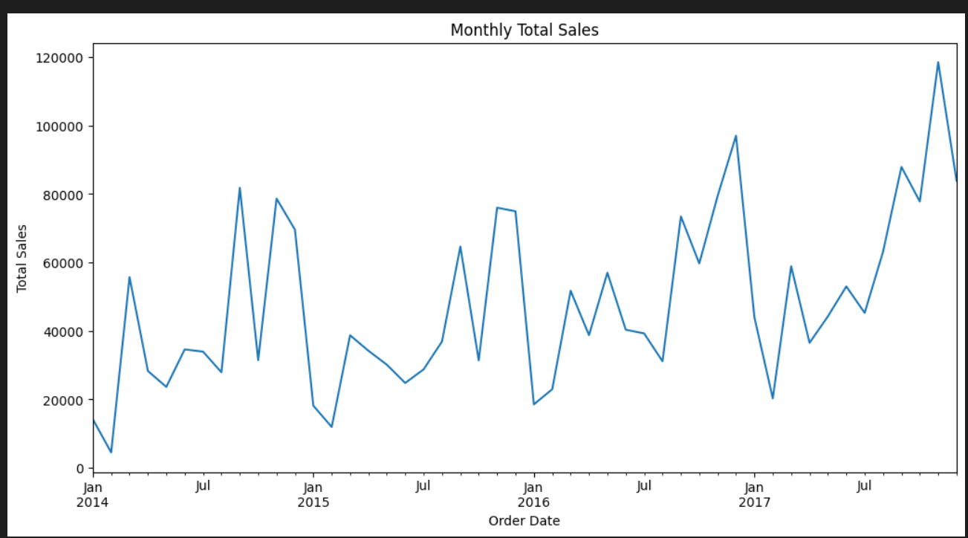
Output

Slide 16
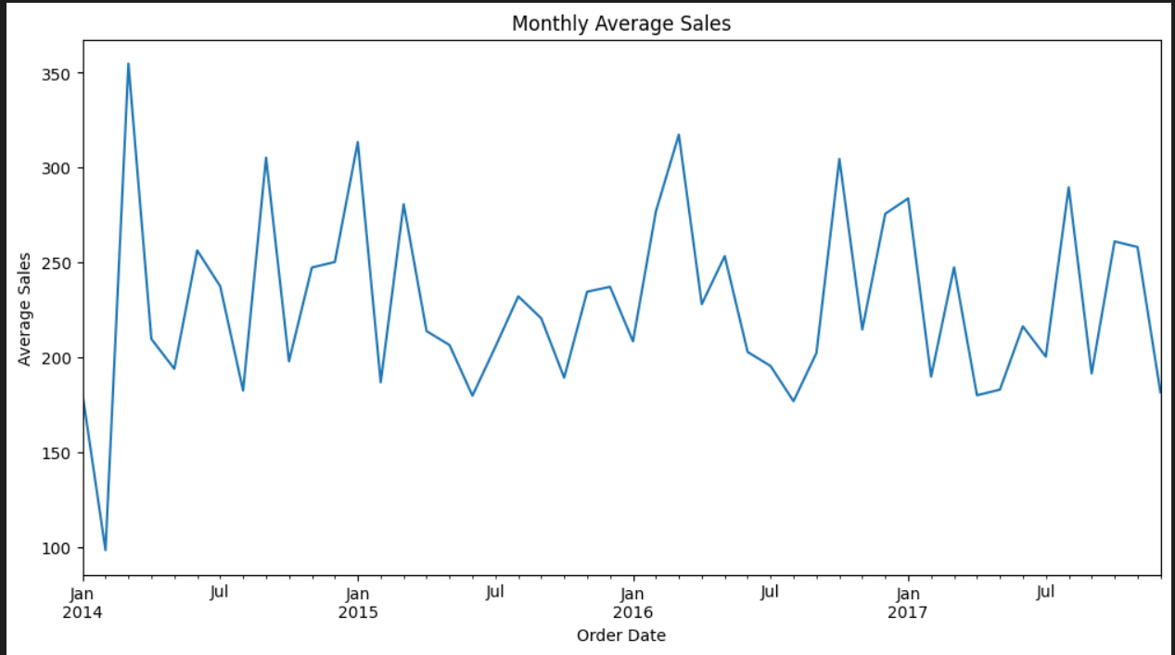
Output

Slide 17
INFERENCE: Monthly order frequency shows regular fluctuations, while total sales peaked in August 2017. Average sales fluctuate with periodic peaks. INTERPRETATION: The cyclical pattern in monthly order frequency implies seasonal trends. August 2014's peak in total sales indicates a significant period, while consistent sales in Nov-Dec 2015 and fluctuating patterns in 2016-2017 and a peak after august 2017 suggest dynamic market conditions. Average sales, peaking in Feb 2014, exhibit periodic fluctuations, indicating varying customer behaviors.
“
”

Slide 18
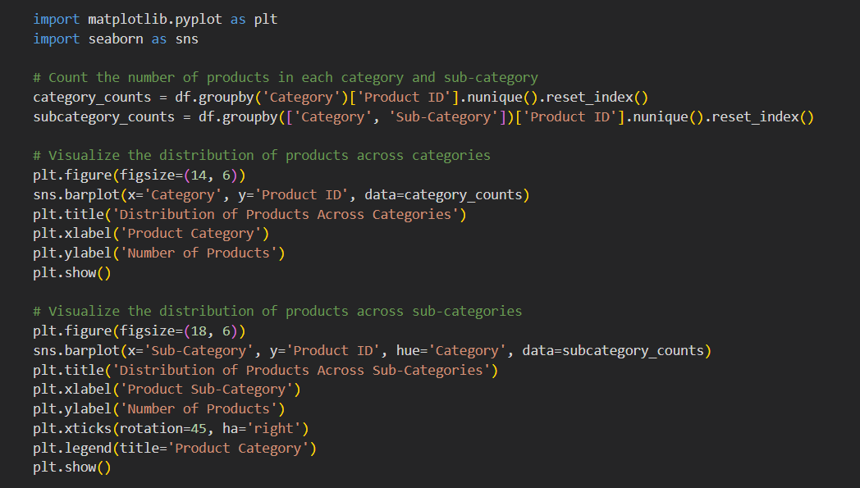
Examining the distribution of products across categories and sub-categories

Slide 19
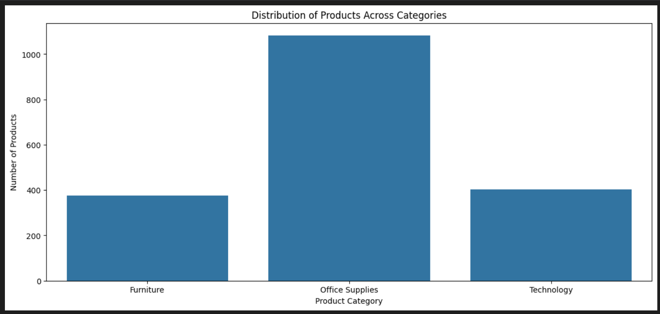
Output

Slide 20
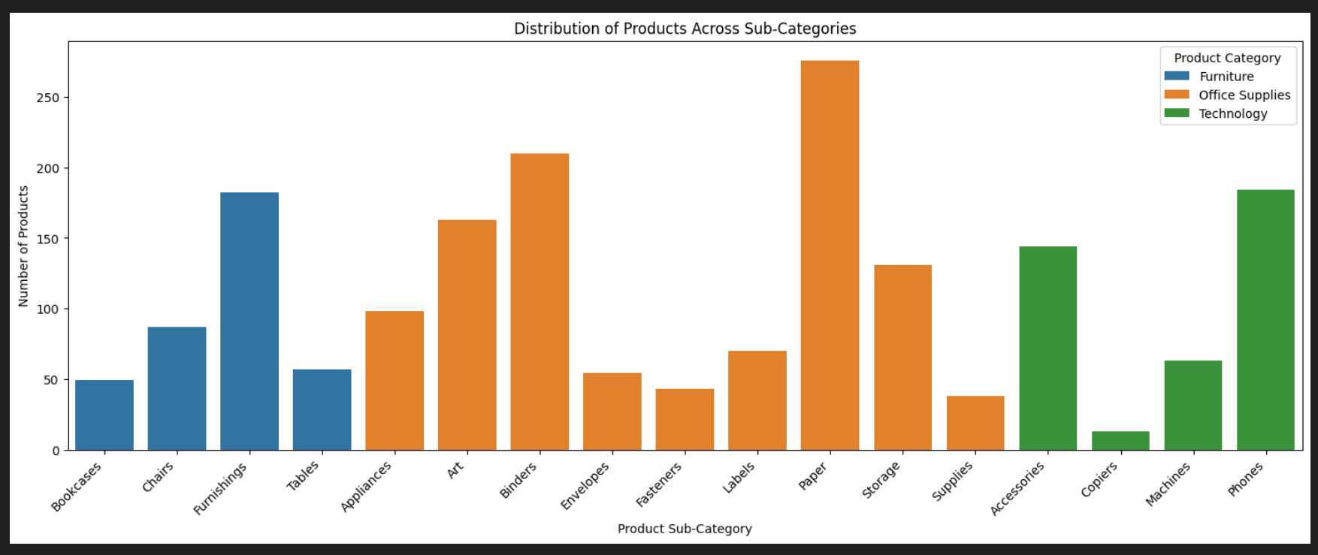
Output

Slide 21
INFERENCE: Office Supplies lead, particularly in Paper products. Furniture sees Furnishings dominance, while Phones prevail in Technology, overshadowing Copiers. INTERPRETATION: The data suggests a strong demand for diverse office supplies, with a focus on paper-related items. Furnishings lead in the furniture category, hinting at varied non-essential items. Technology preferences lean towards Phones, indicating a greater emphasis on communication technology, while Copiers' low representation suggests potentially lower demand for specialized office machinery in the dataset.
“
”

Slide 22
Conclusion
In conclusion, the outlined objectives aim to provide a comprehensive understanding of the business dynamics. Correlation analysis will unveil interdependencies, top product identification aids strategic decisions, time series analysis uncovers trends, and distribution examination guides marketing and expansion strategies for overall business optimization.

Slide 23
References
https://community.tableau.com/s/question/0D54T00000CWeX8SAL/sample-superstore-sales-excelxls
https://www.kaggle.com/
https://medium.com/analytics-vidhya/exploratory-data-analysis-super-store-cb91c37bcb06

Slide 24

Thank you

